Slide 1

SERVERLESS COMPUTING
- MANSOUREH LORD, ASHU GURU, KARTHIKA DHARMIA RAJENDRAN

Slide 2
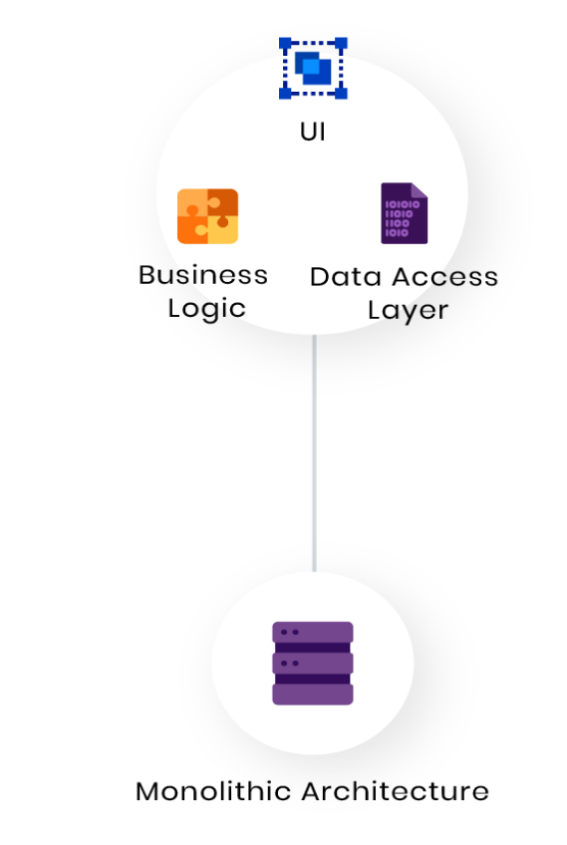
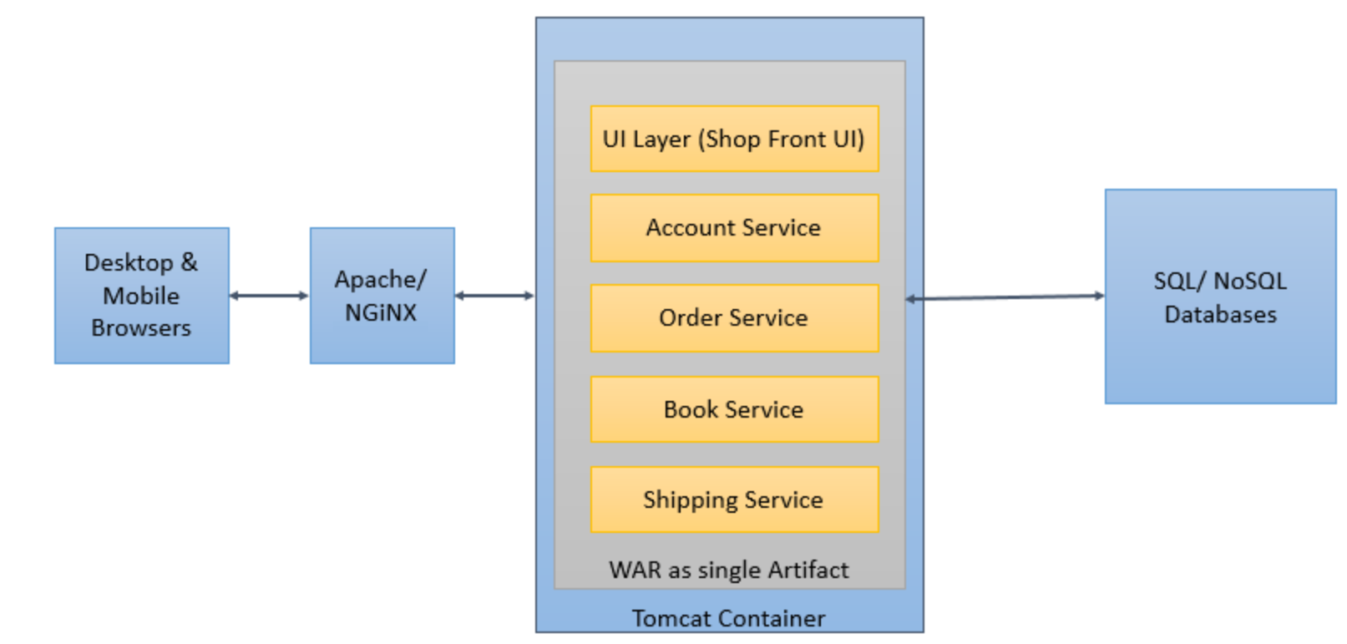
Traditional monolithic architecture

Slide 3
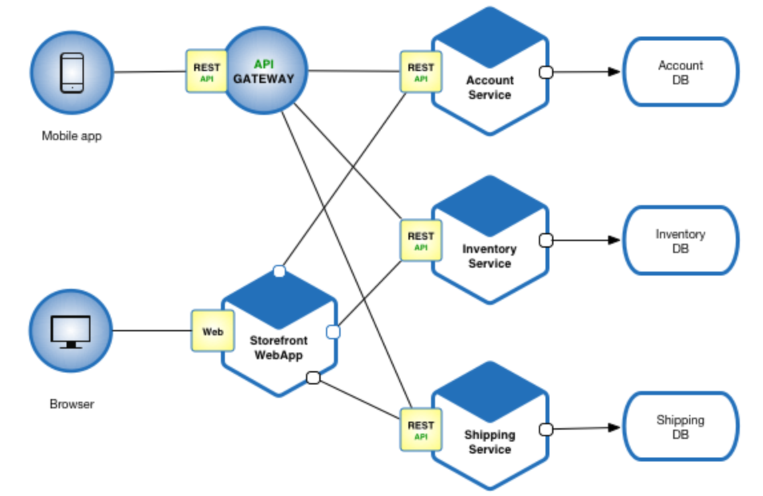
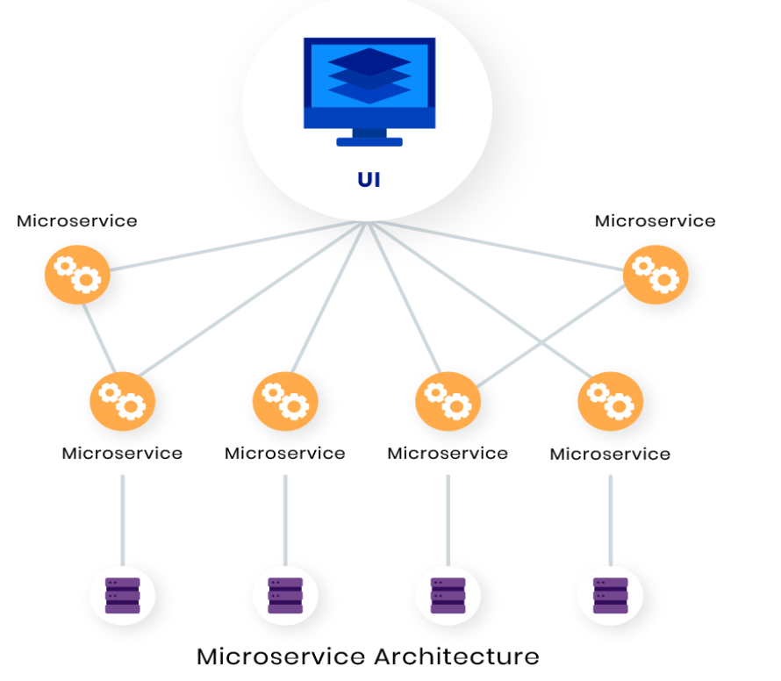
Microservices - Application as loosely coupled services

Slide 4
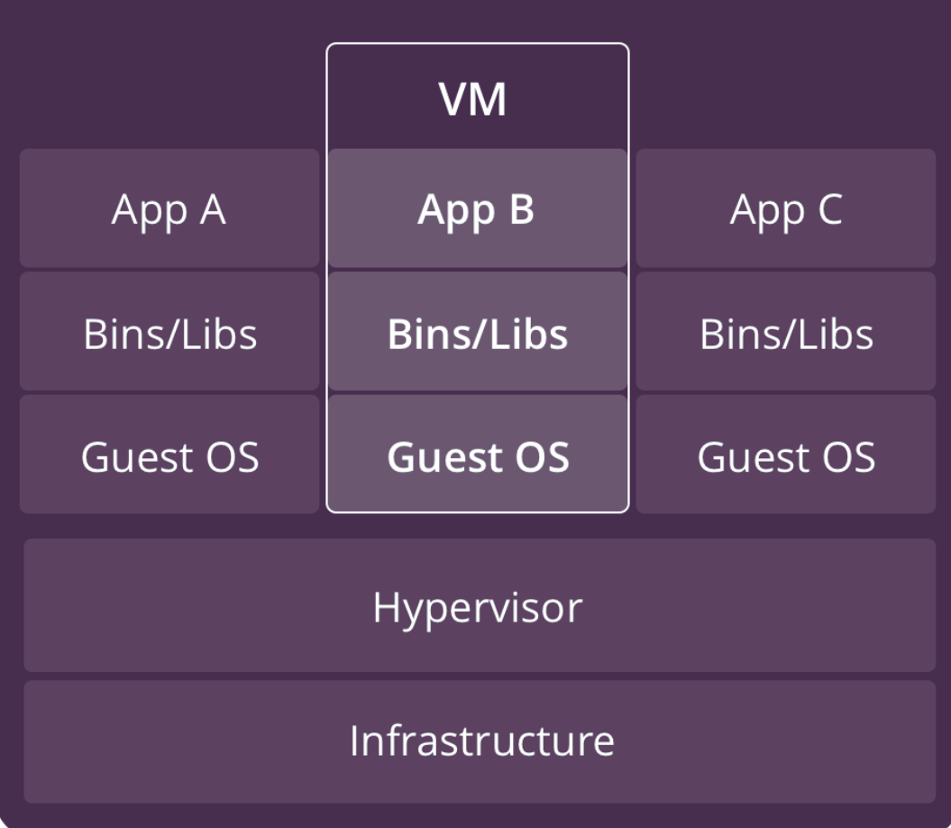
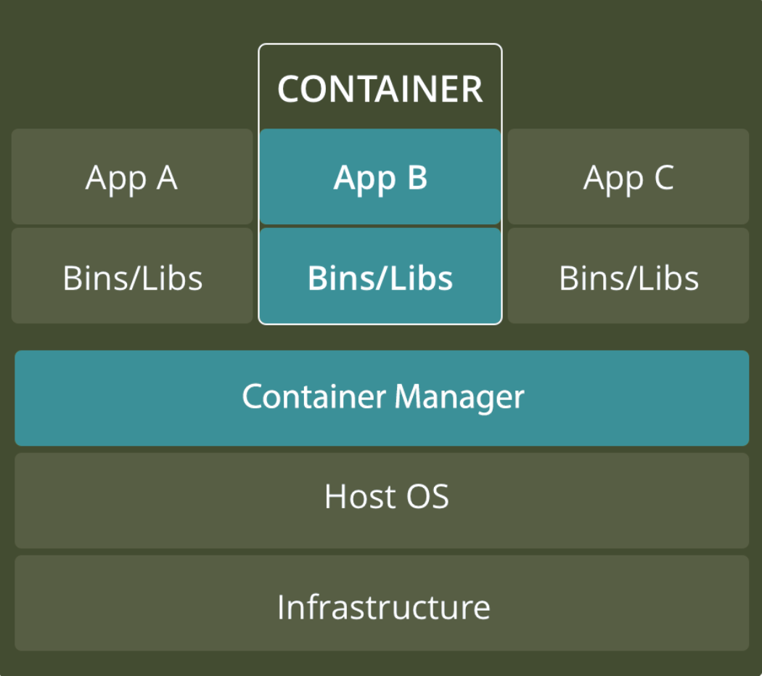
Virtualized Technologies

Slide 5
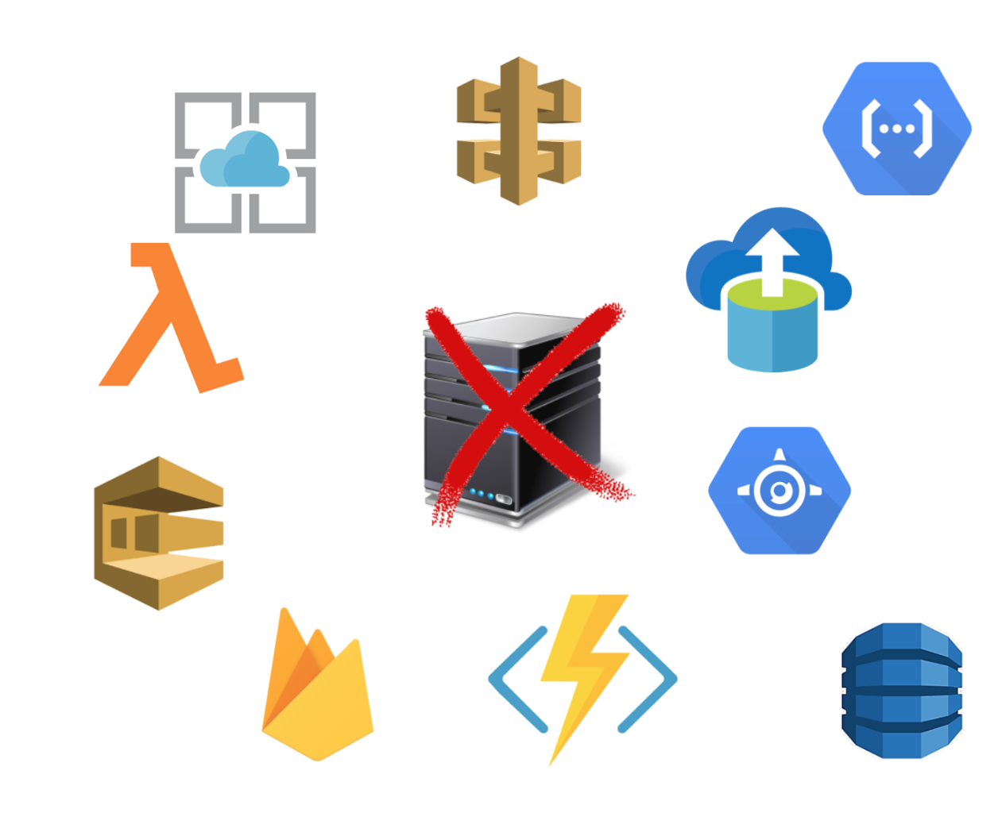




Future Forward…...GO SERVERLESS
No servers to provision or manage
Scales with usage
Pay for value
Availability and fault tolerance built in

Slide 6
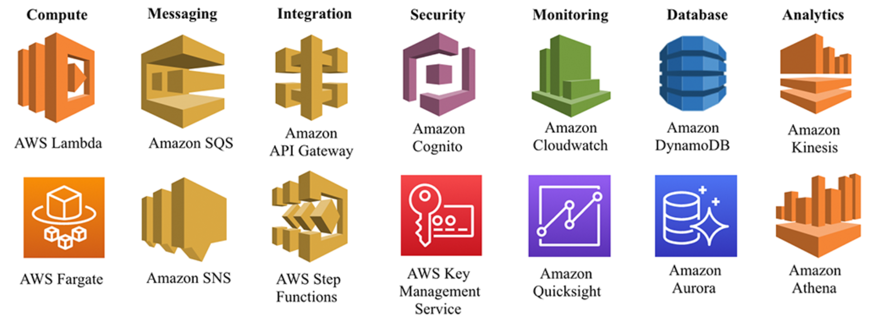
Diving Deeper…..

Slide 7
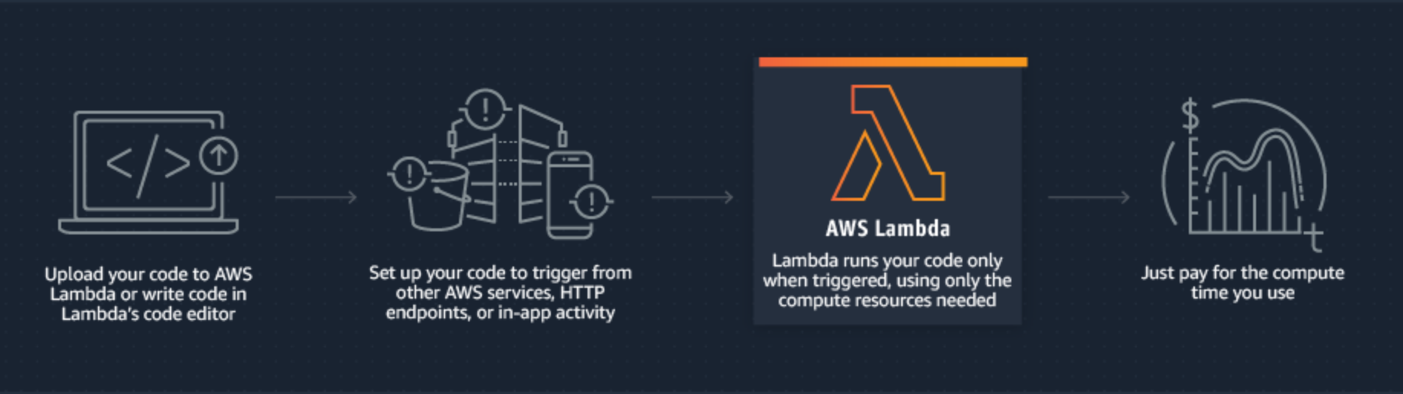
How does Lambda work?
https://aws.amazon.com/lambda/

Slide 8
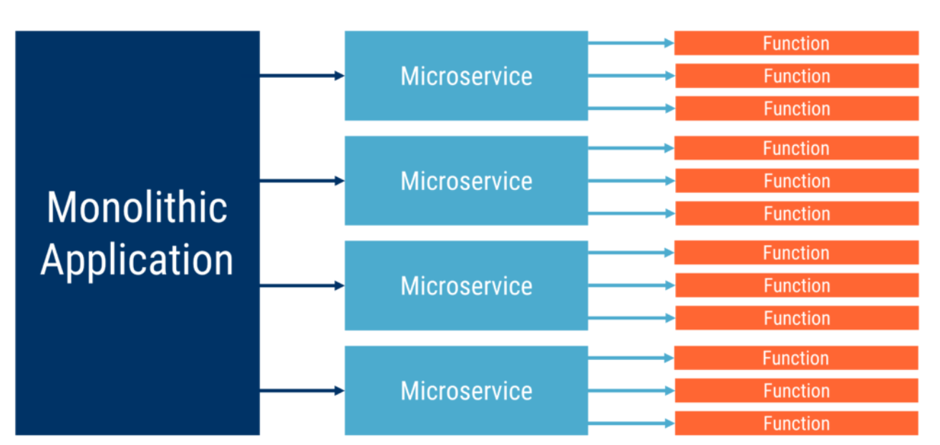
Functions provide further application granularity

Slide 9
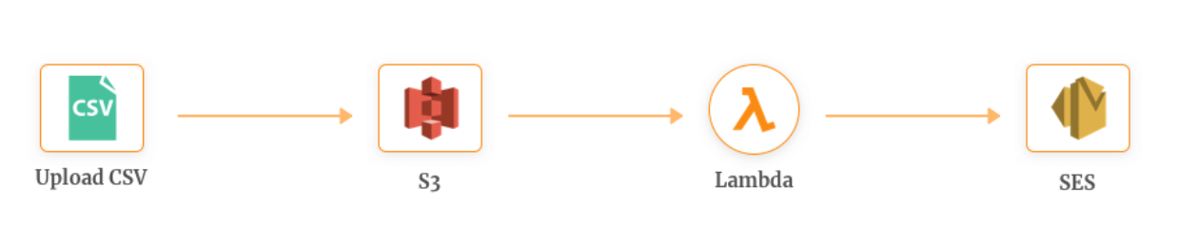
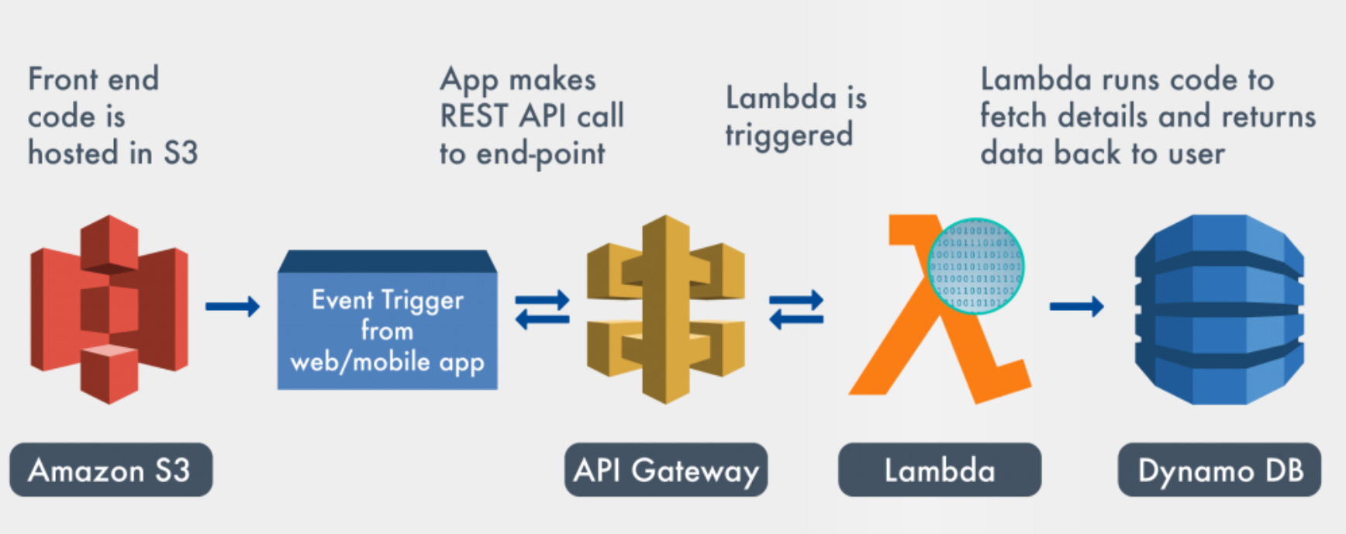
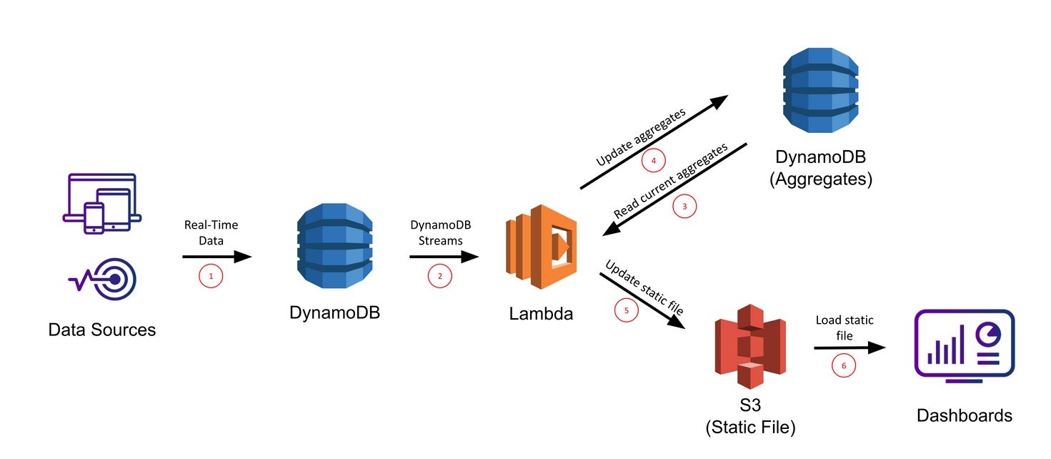
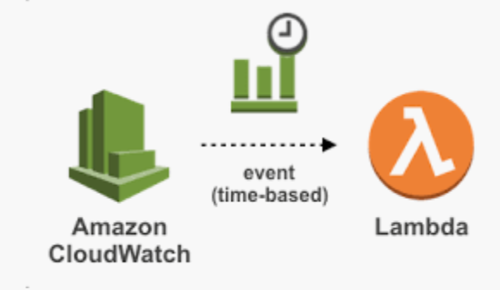
Events Trigger AWS Lambda Function
S3 event API Gateway event
DynamoDB event CloudWatch event

Slide 10
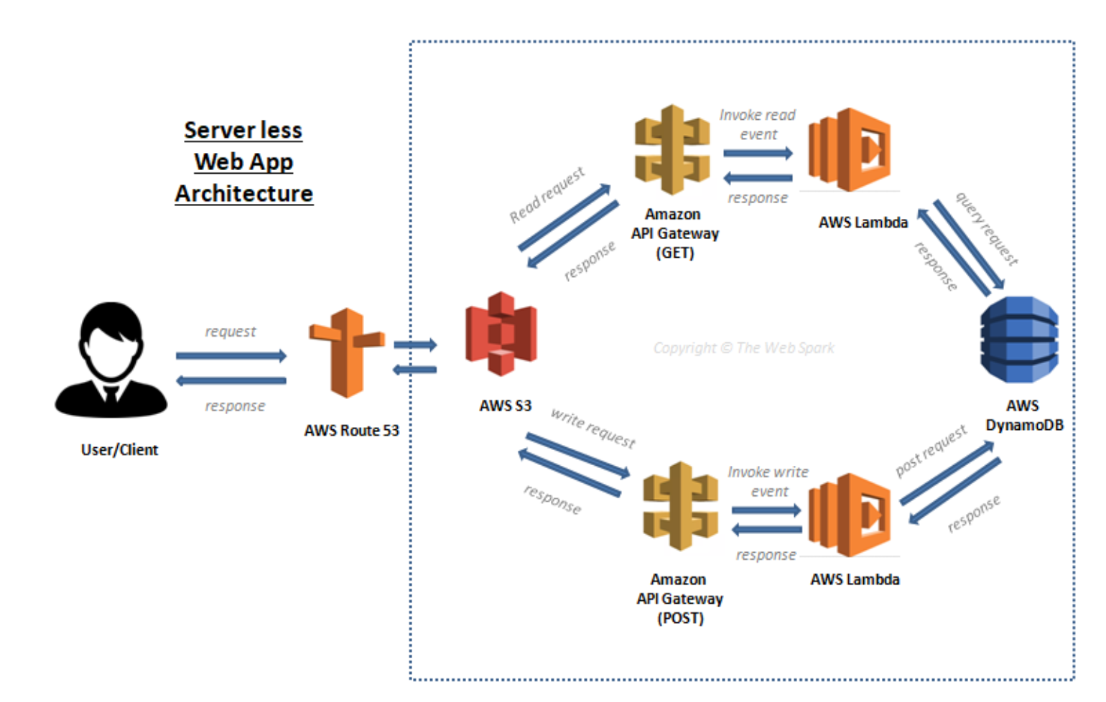
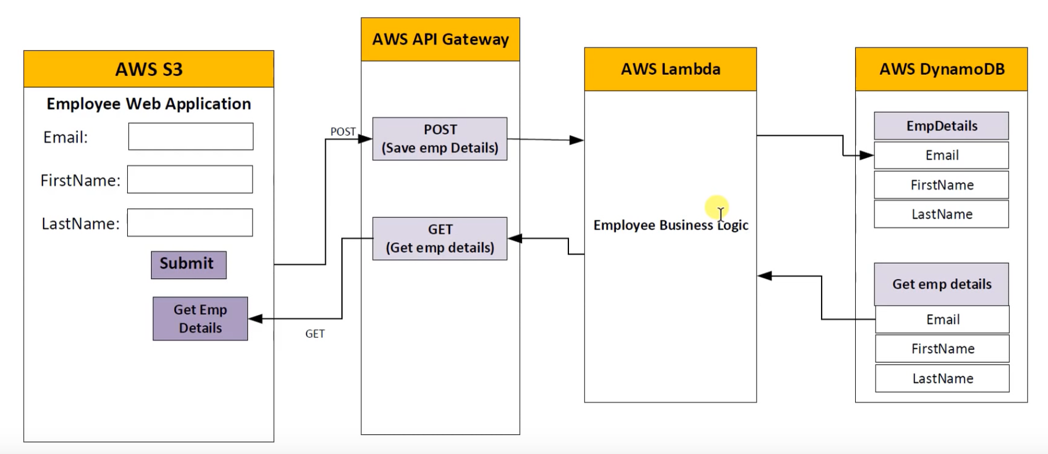
A web page extracting employee details

Slide 11
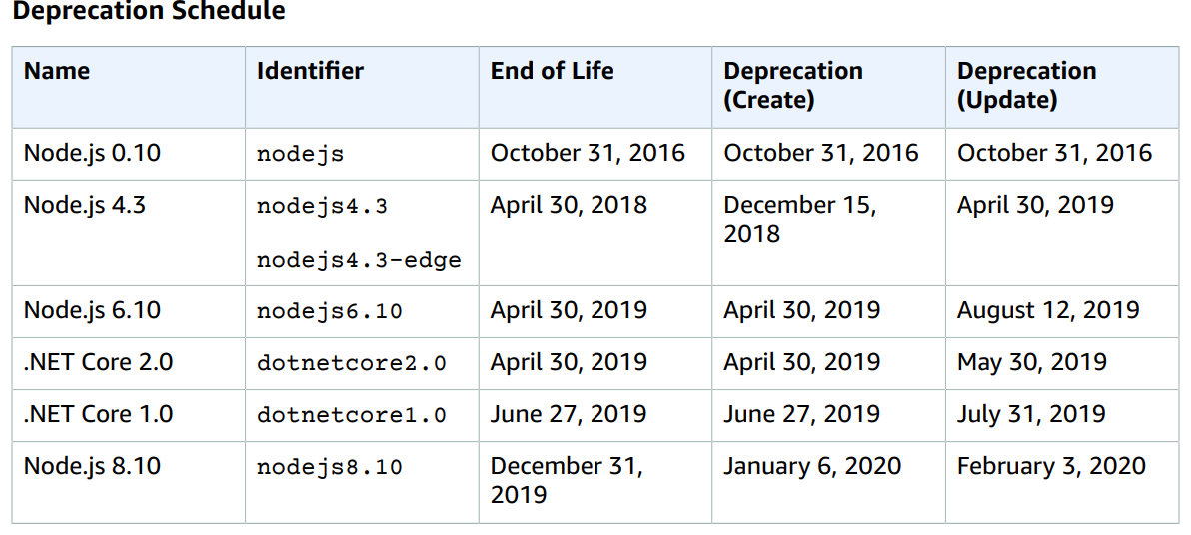
AWS Lambda Execution context and Limitations
Languages supported
Node.js
Python
Ruby
Java
Go
.NET Core

Slide 12
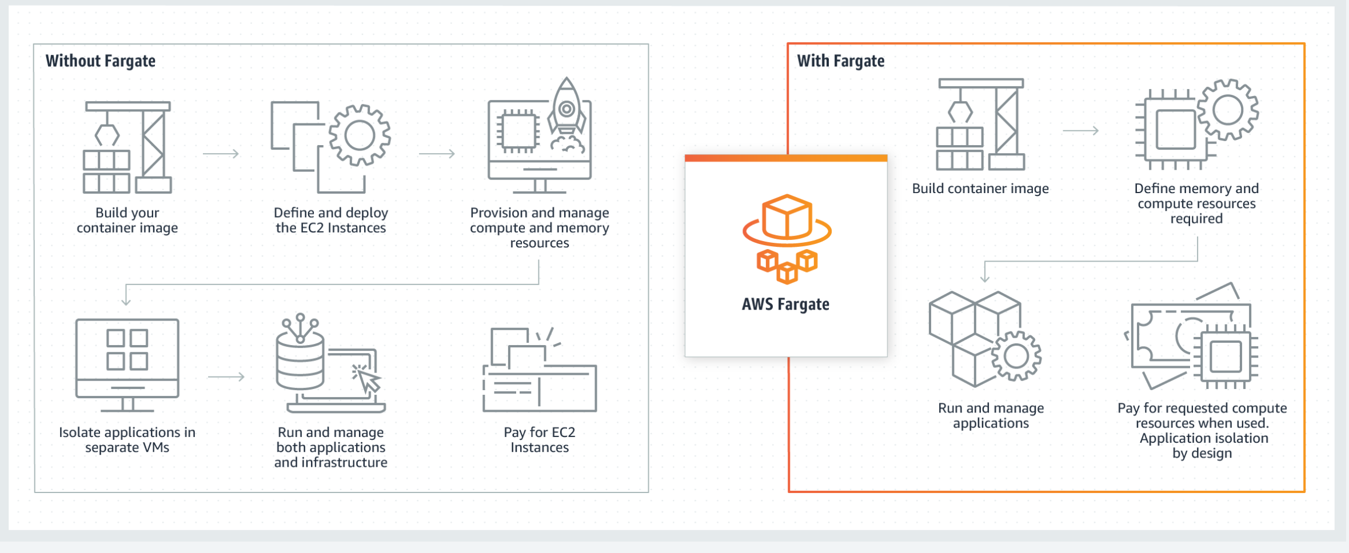
Managed Container Services
https://aws.amazon.com/lambda/

Slide 13
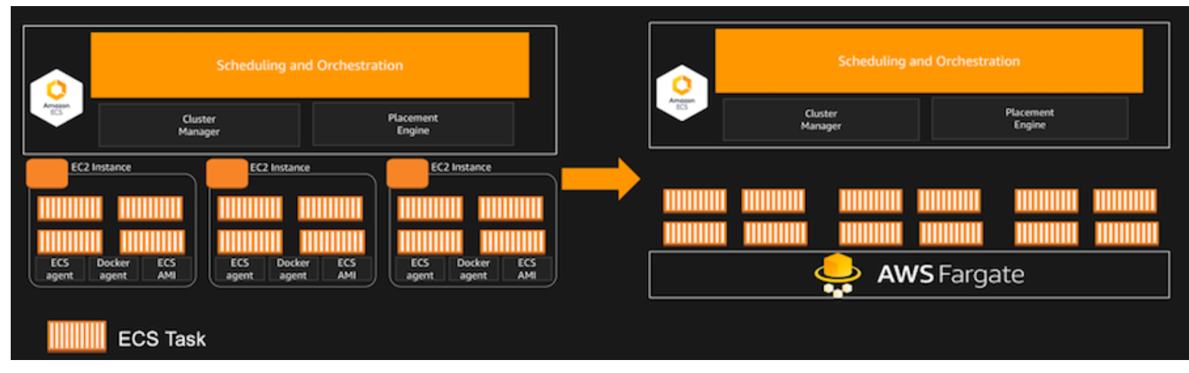
Run Containers Serverless
https://aws.amazon.com/blogs/aws/aws-fargate/

Slide 14
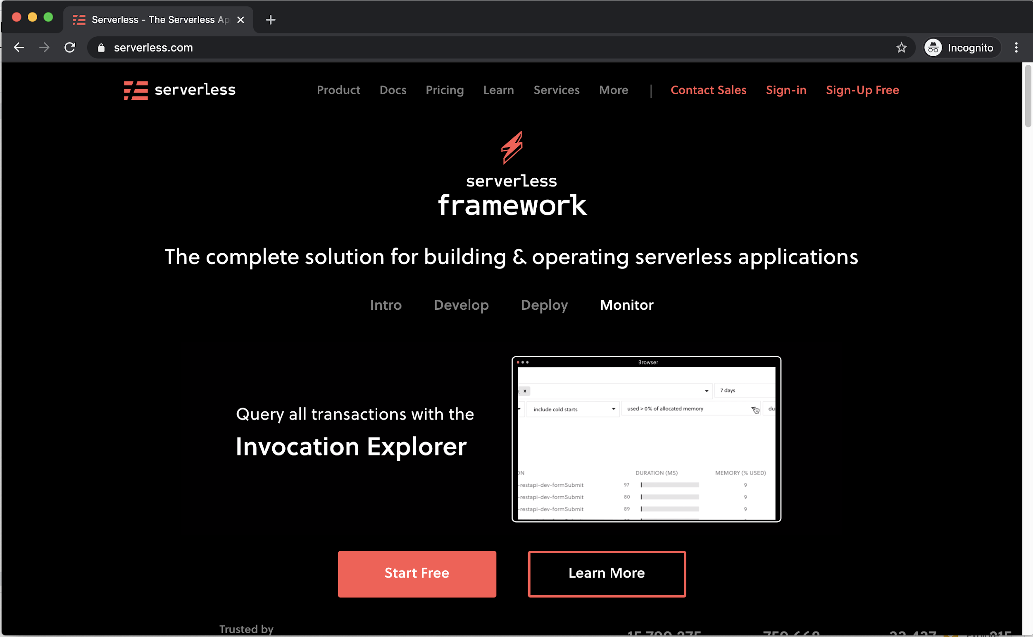

Slide 15
Toolkit for Building Serverless Applications
AWS Lambda with Amazon Web Services
Microsoft Azure with Azure Functions
IBM Bluemix with IBM Cloud Functions
Google Cloud using Google Cloud Functions
Oracle Cloud using Oracle Fn
Kubeless based on Kubernetes
Spotinst and Webtask by Auth0

Slide 16
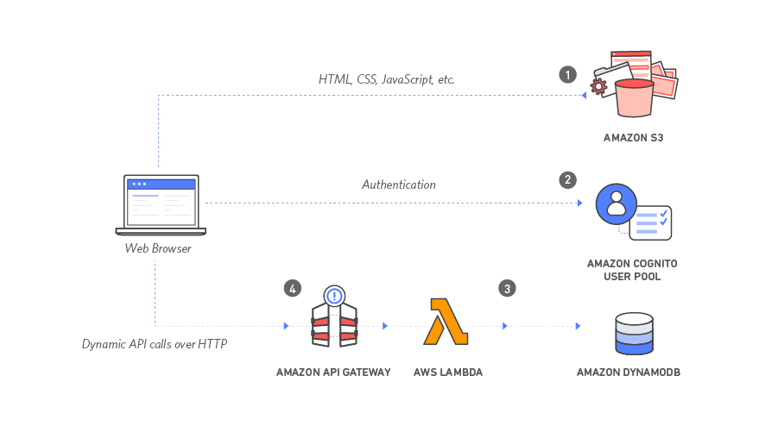
Working Example
Serverless Web Application deployed using Serverless Framework
https://aws.amazon.com/getting-started/projects/build-serverless-web-app-lambda-apigateway-s3-dynamodb-cognito/

Slide 17
Serverless Framework: Fundamentals
Functions - The package of code
Events - The Trigger
Resources - Compute, Storage, etc.
Services - The Project File
Plugins - Extensions

Slide 18
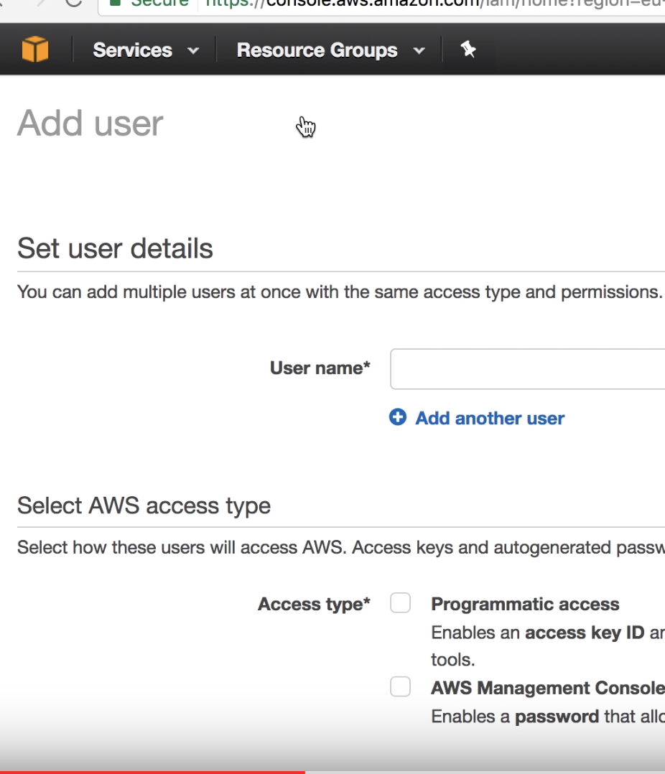
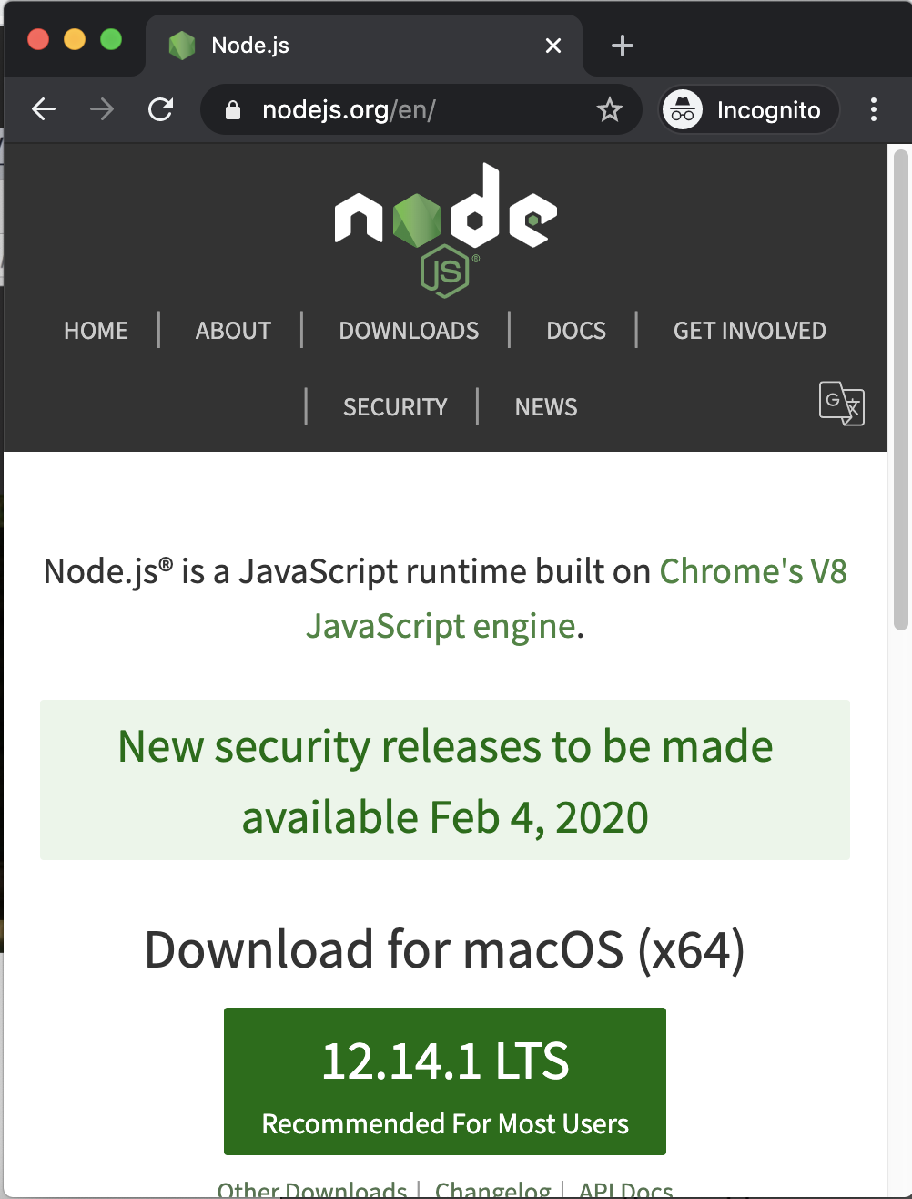
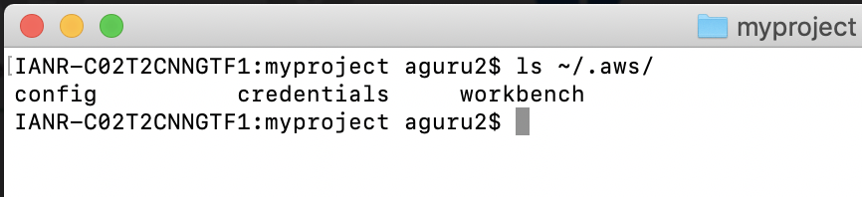
Step 1: Setup Your Environment
1
2
mkdir myproject
sudo npm install -g serverless
cd myproject
3
4
sls config credentials -o --provider aws --key THEKEY --secret THESECRET

Slide 19
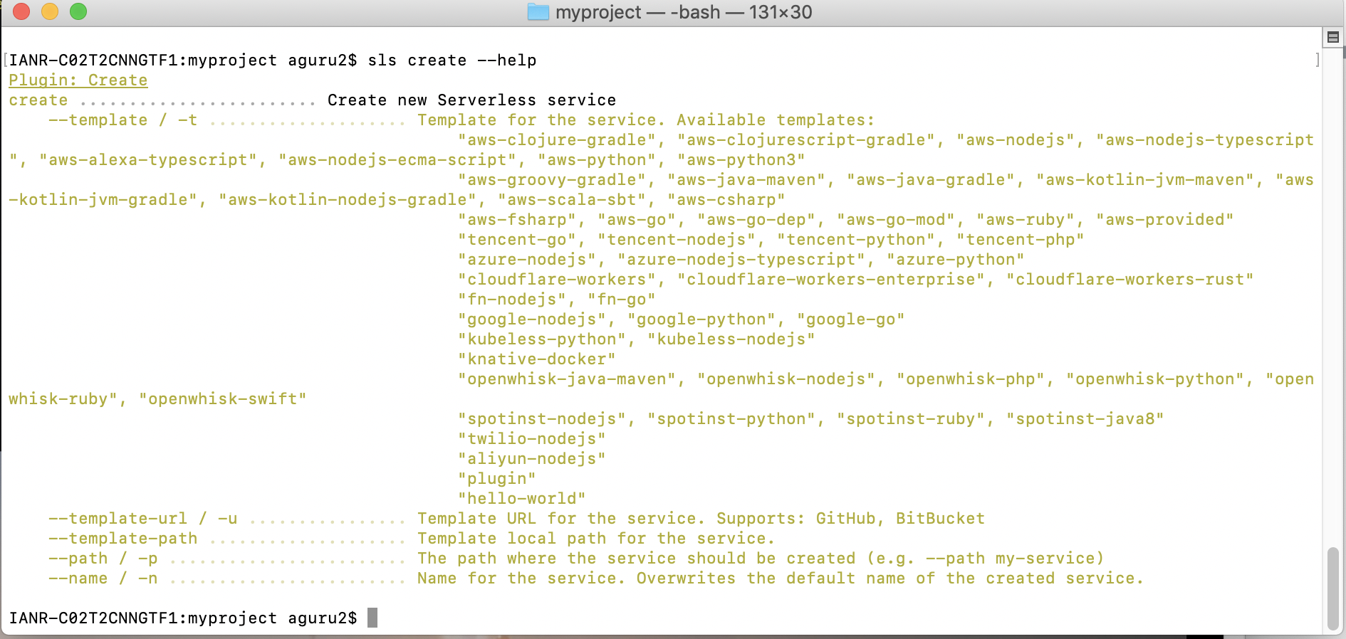
Step 2.1: Generate the Template

Slide 20
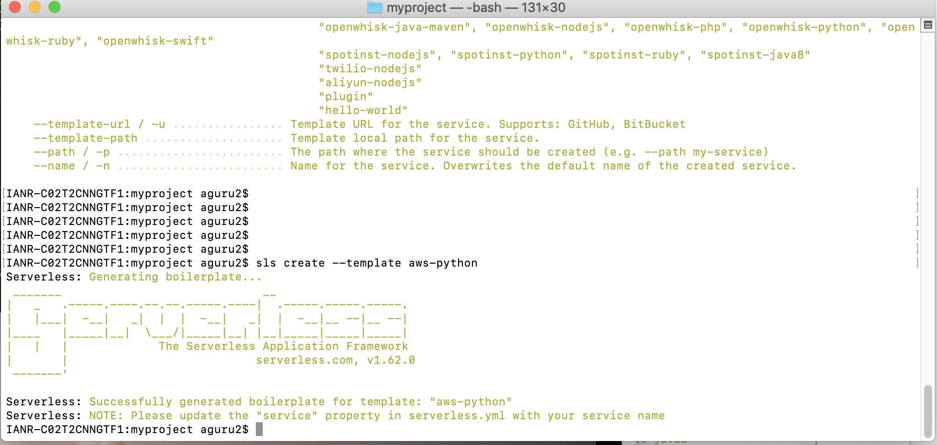
Step 2.2: Generate the Template

Slide 21
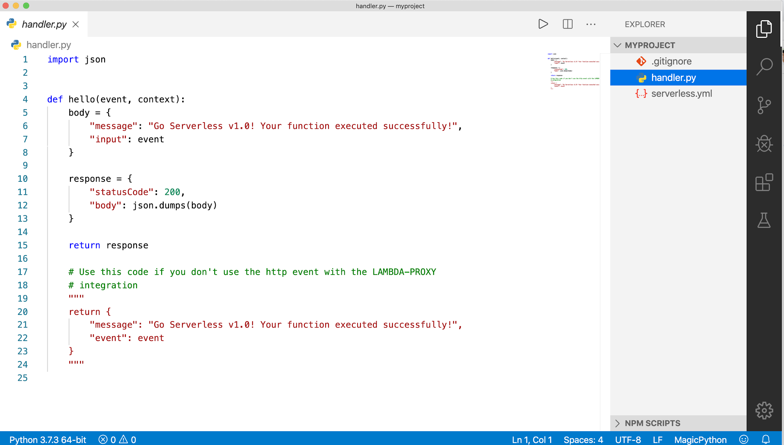
Step 3: Write the Functions

Slide 22
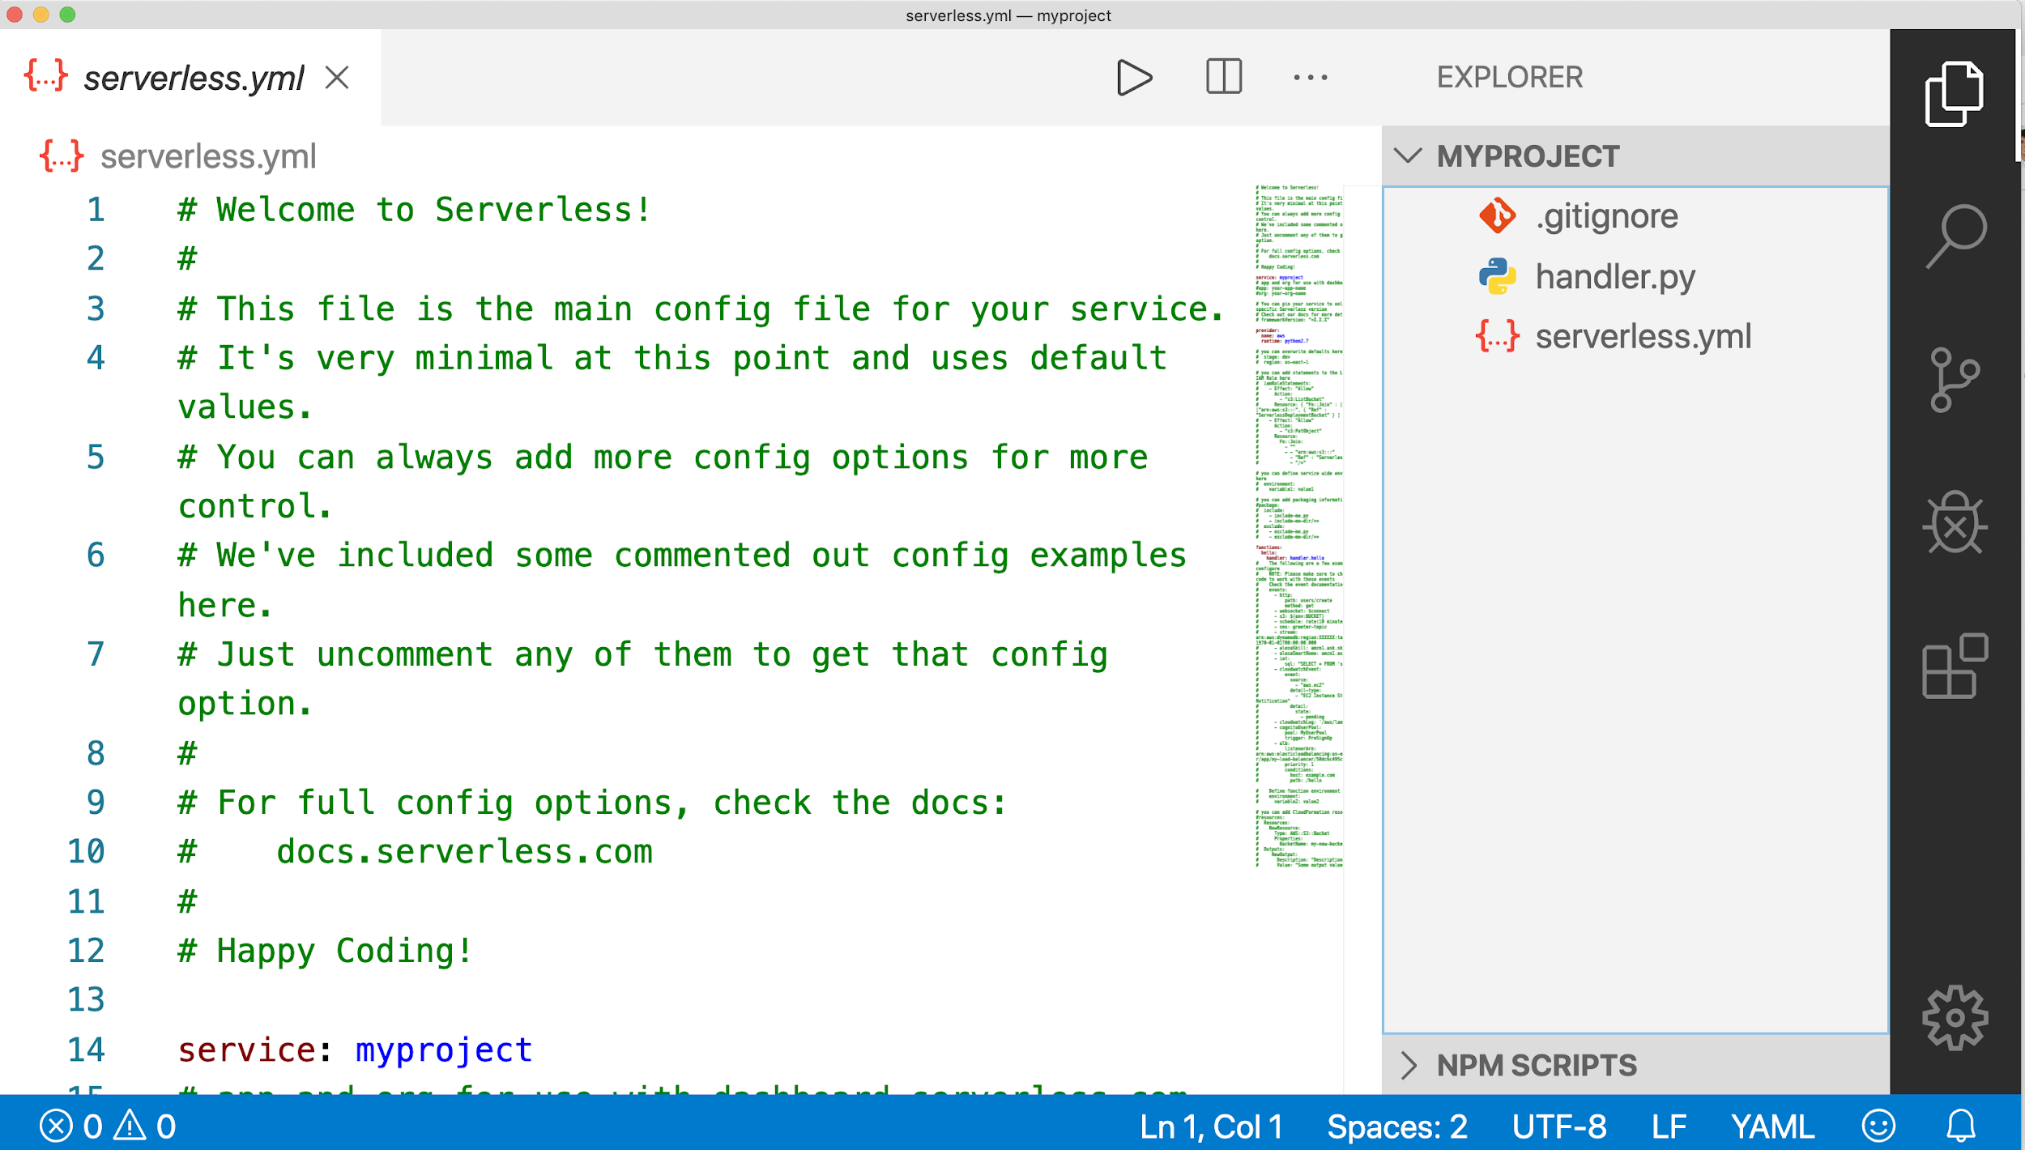
Step 4: Configure the Services

Slide 23
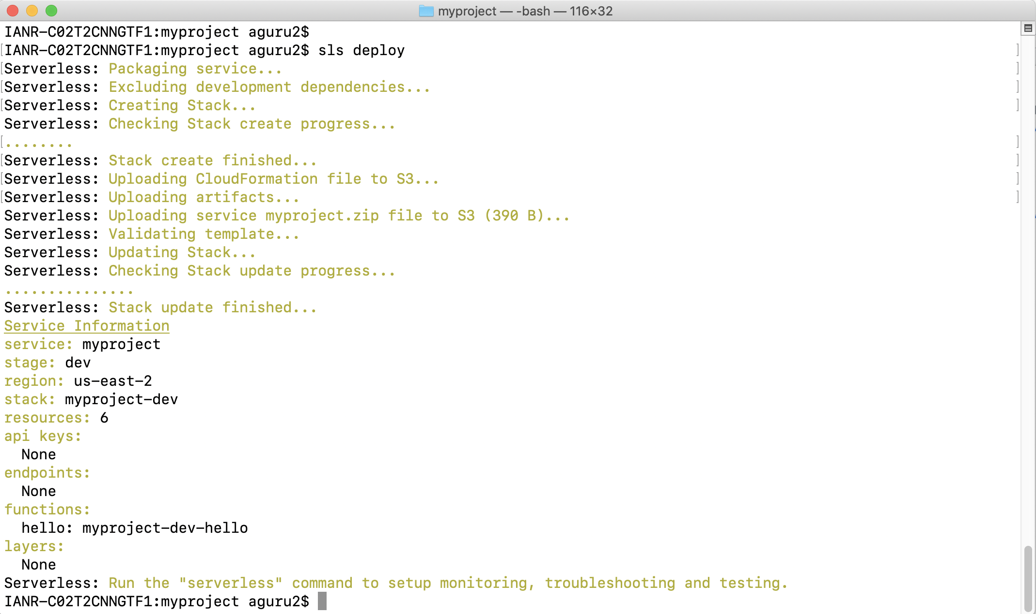
Step 5: Deploy

Slide 24
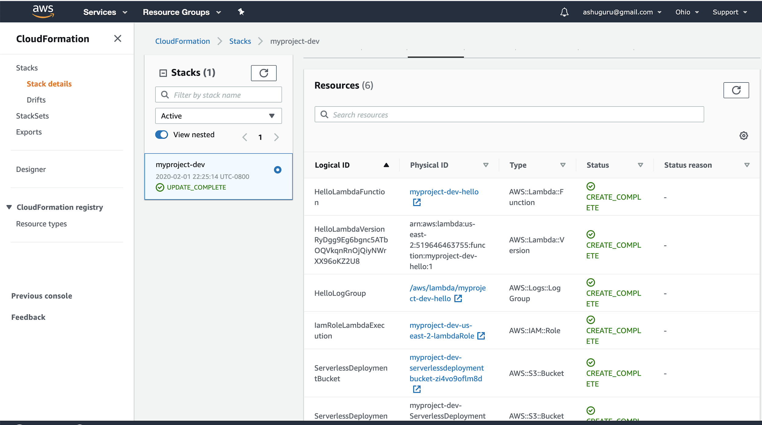

Slide 25
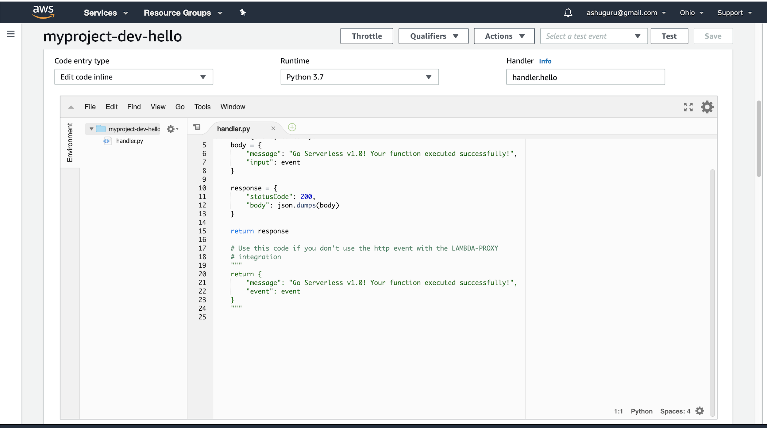

Slide 26
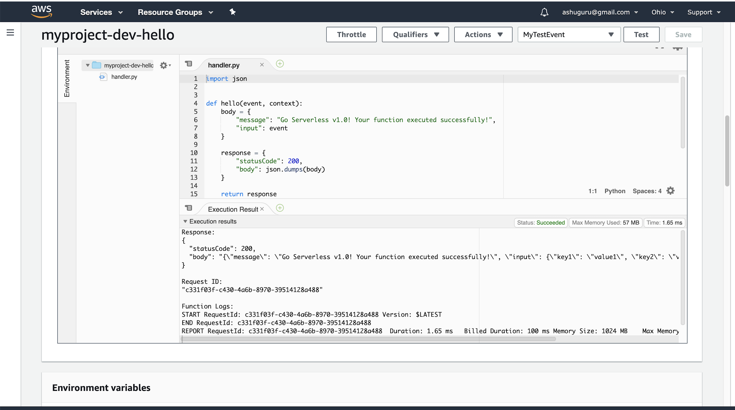

Slide 27
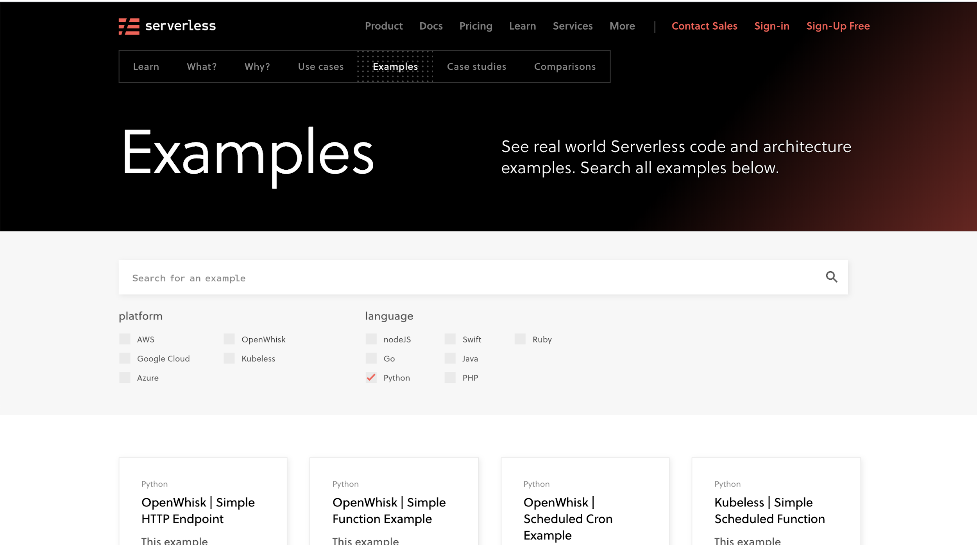

Slide 28
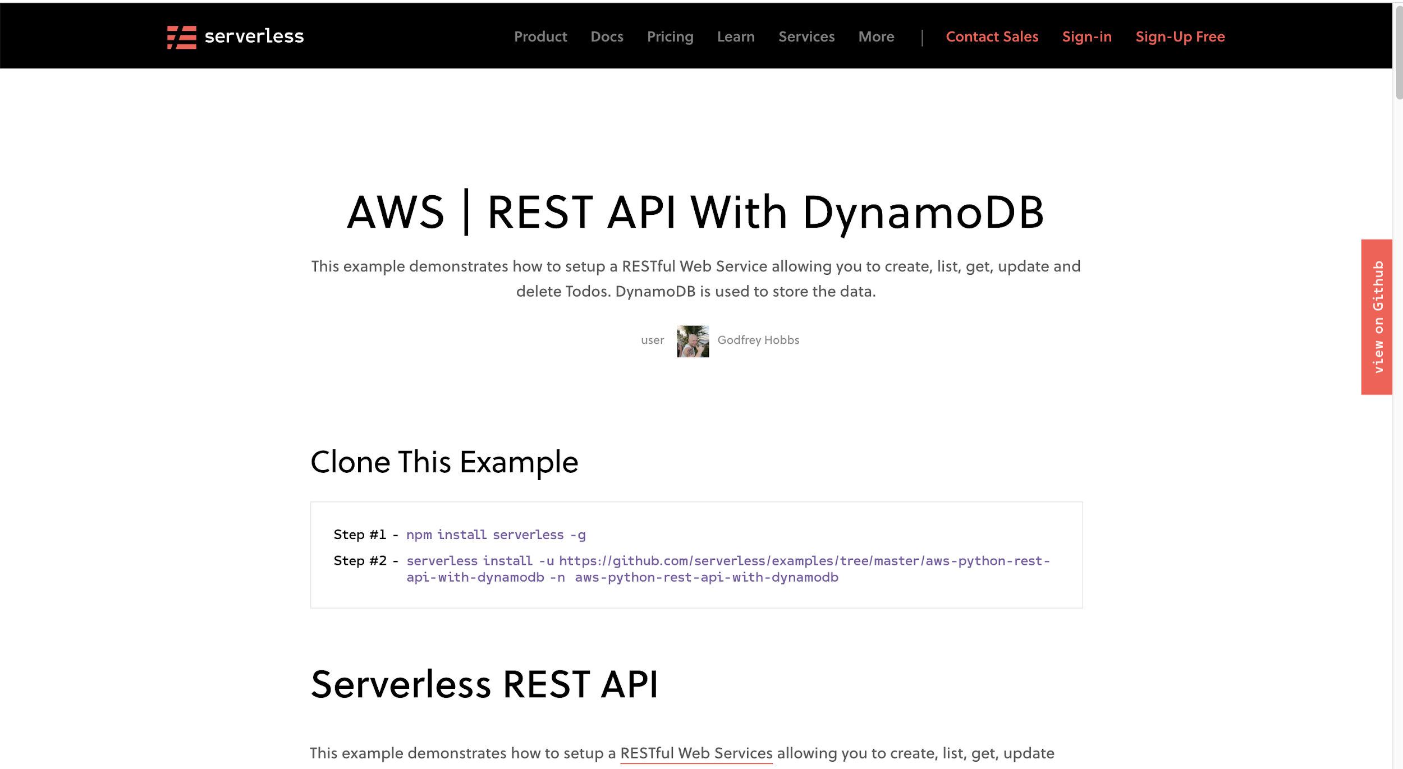

Slide 29

Machine Learning with AWS Serverless

Slide 30
Explosion in machine learning use cases
Image recognition and tagging for photo organization
Object detection, tracking and navigation for Autonomous Vehicles
Speech recognition and synthesis in Intelligent Voice Assistants
Algorithmic trading strategy performance improvement
Sentiment analysis for targeted advertisements

Slide 31
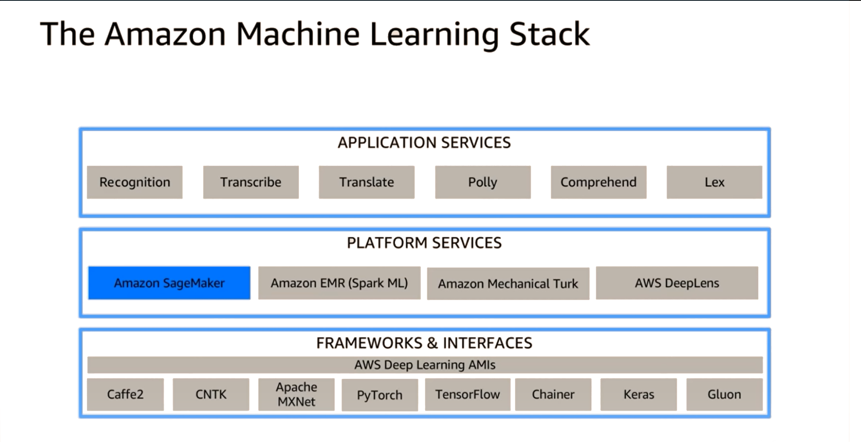

Slide 32
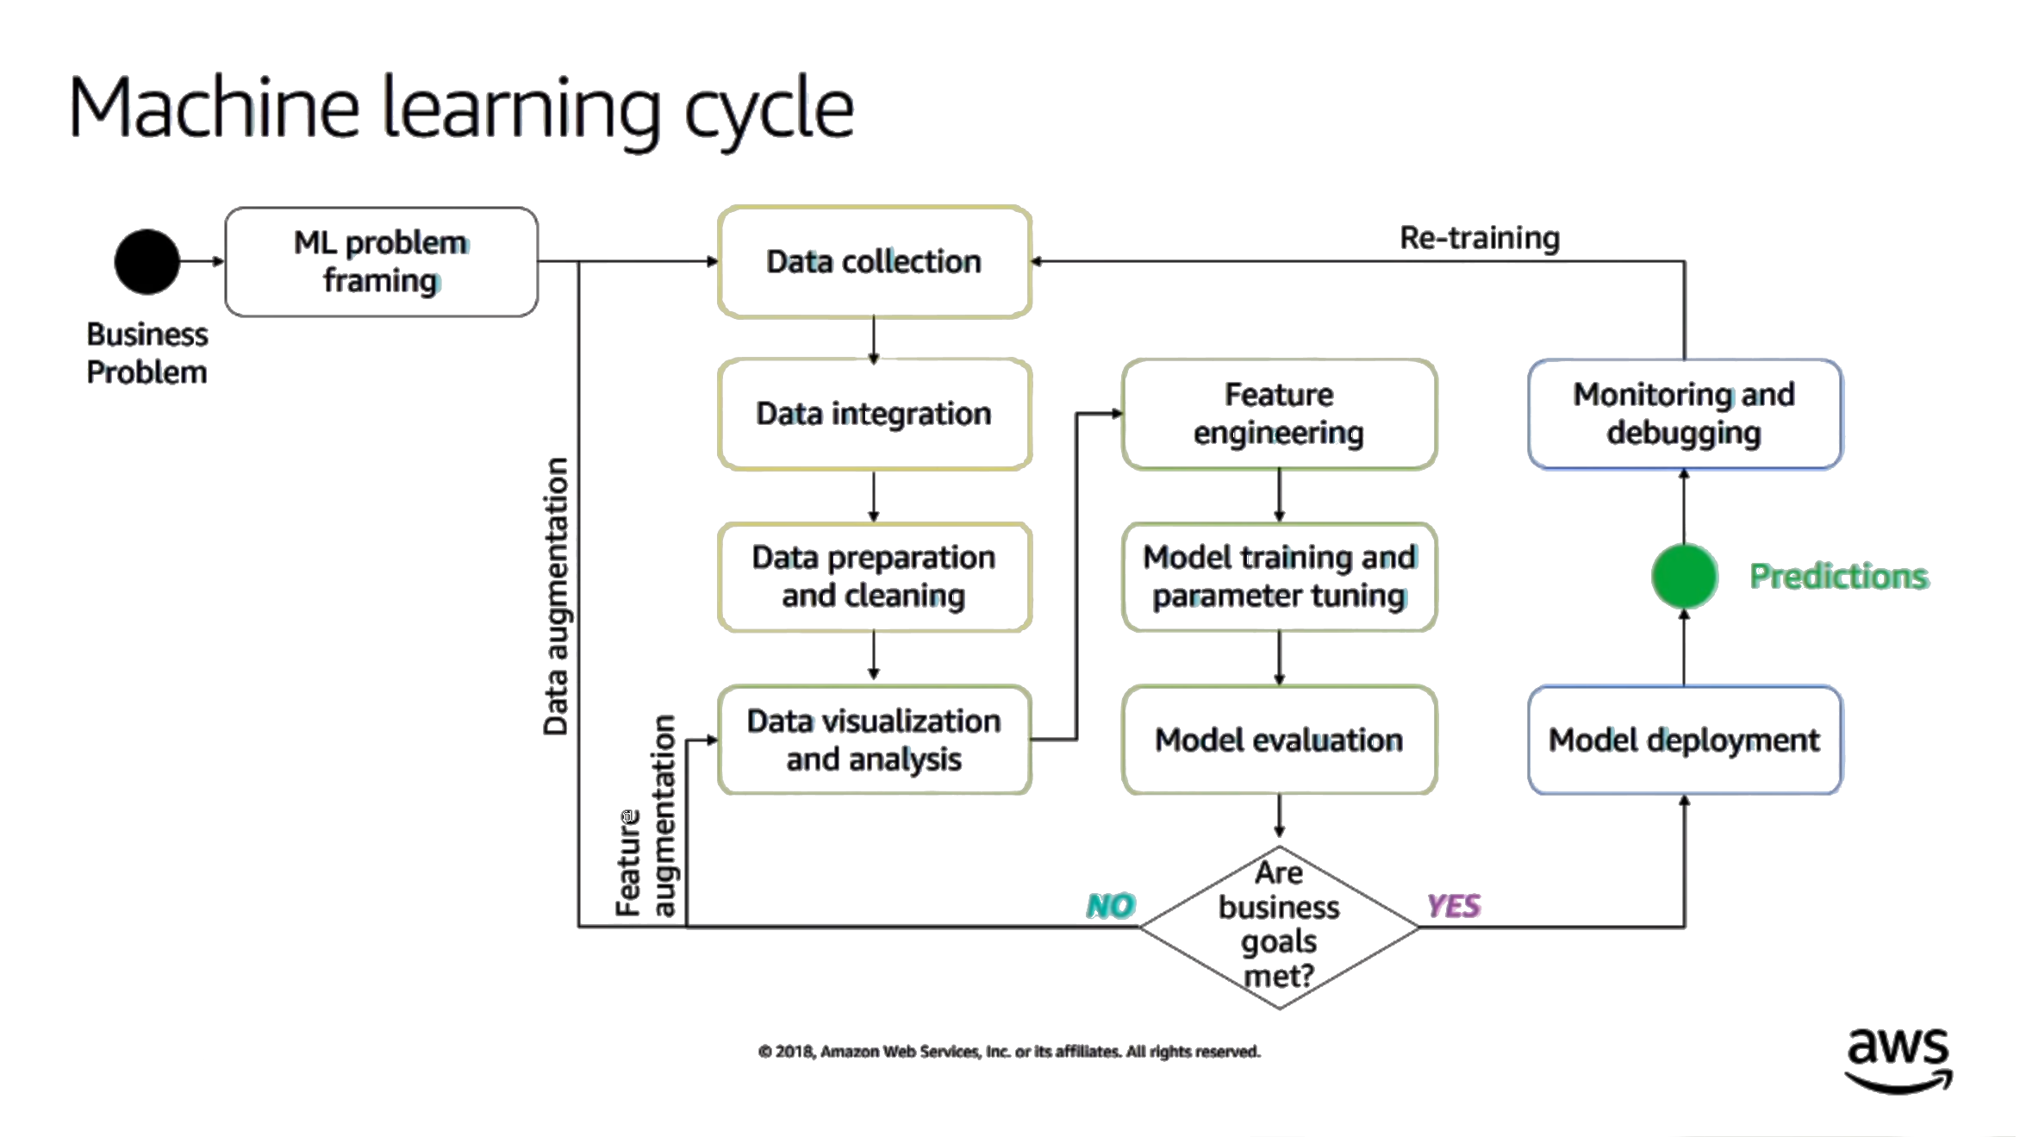

Slide 33
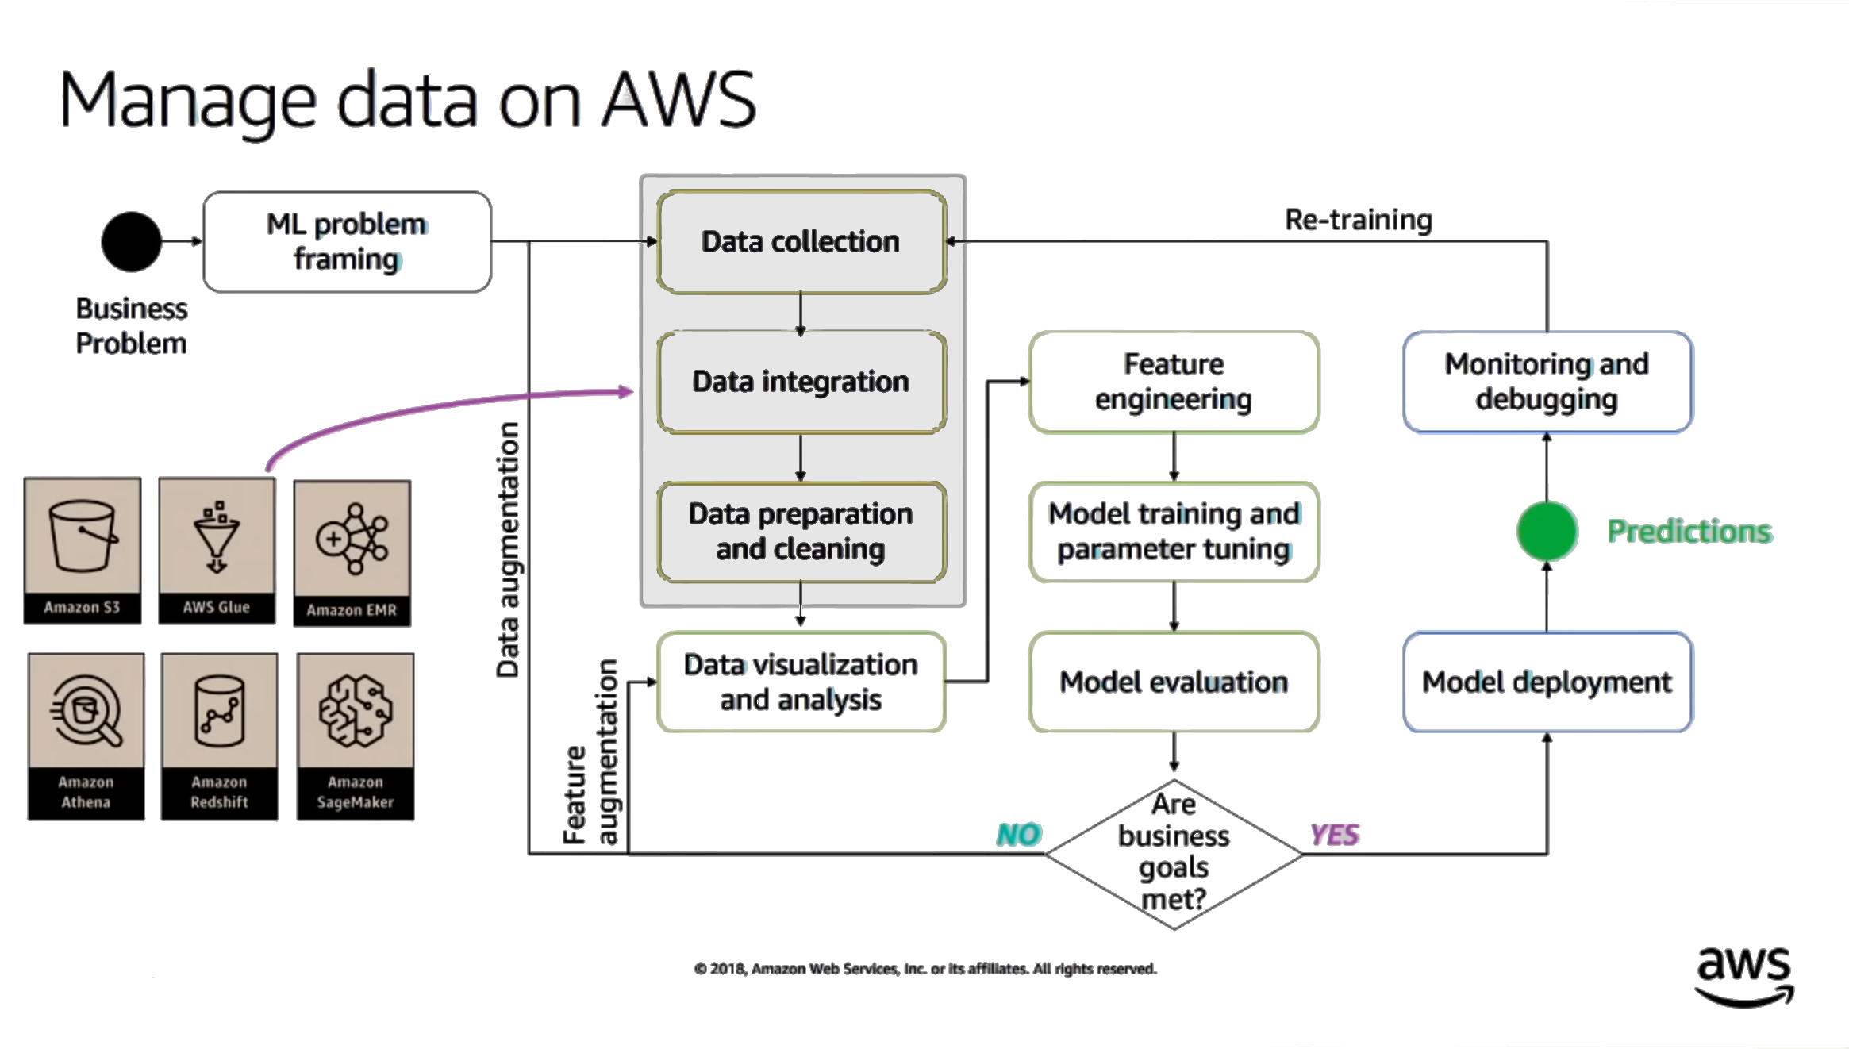

Slide 34
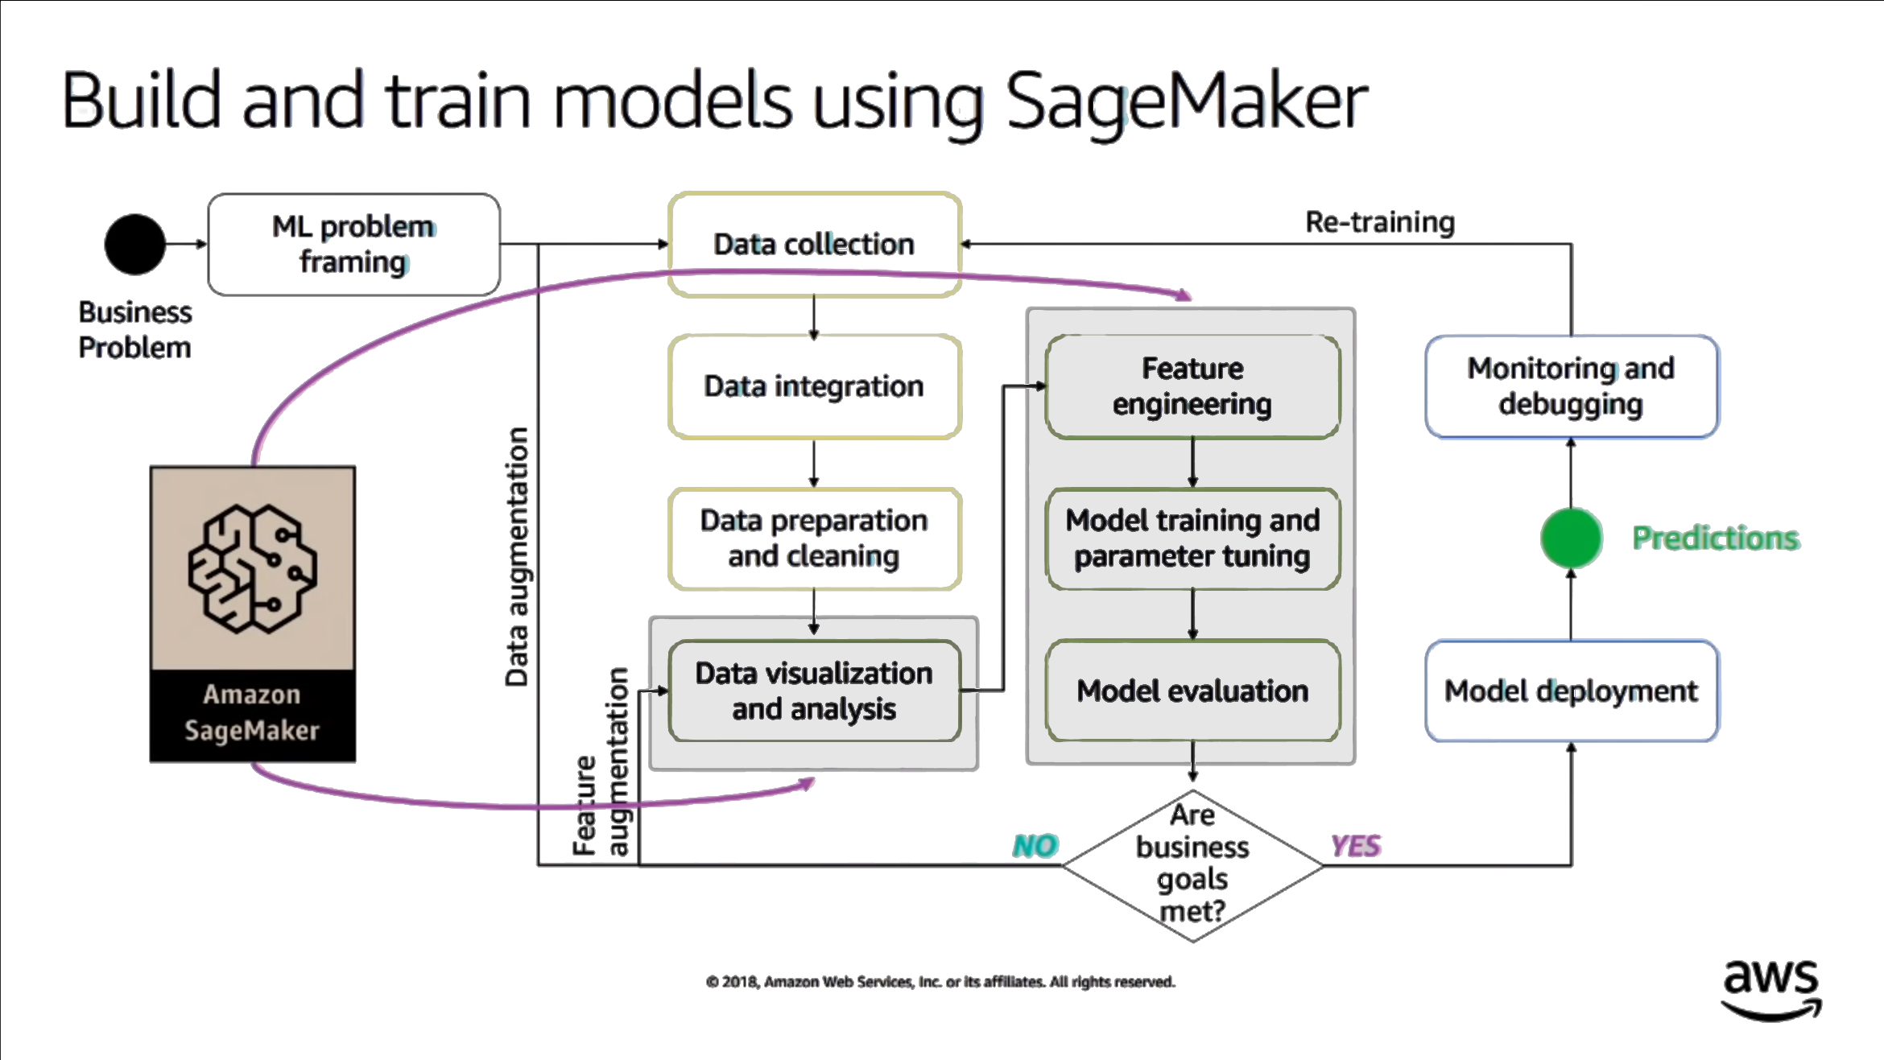

Slide 35
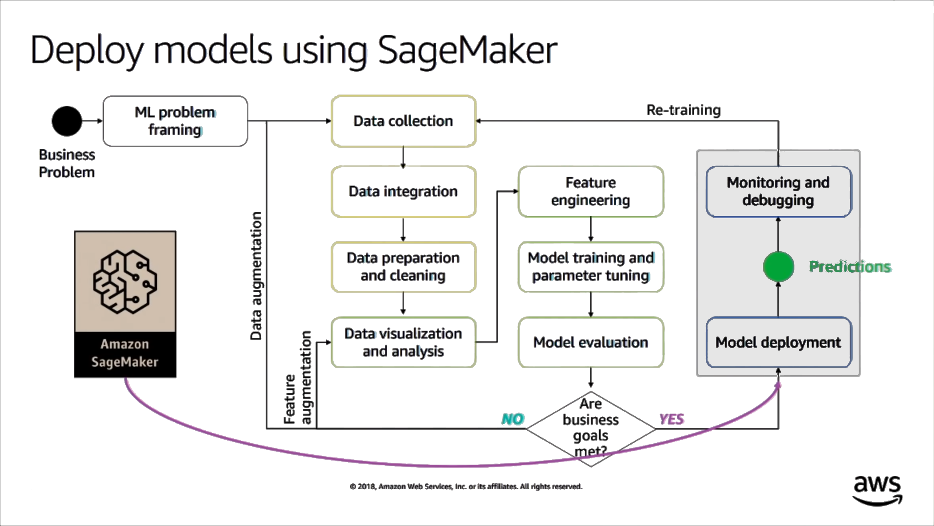

Slide 36
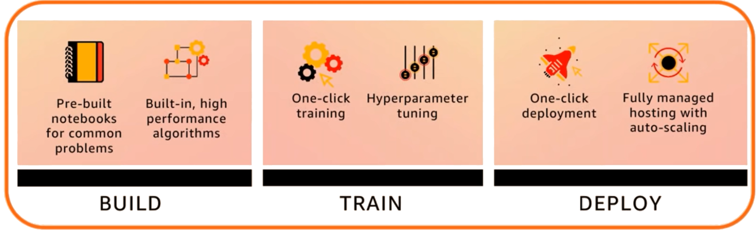
SageMaker
easily build, train , and deploy machine learning models

Slide 37
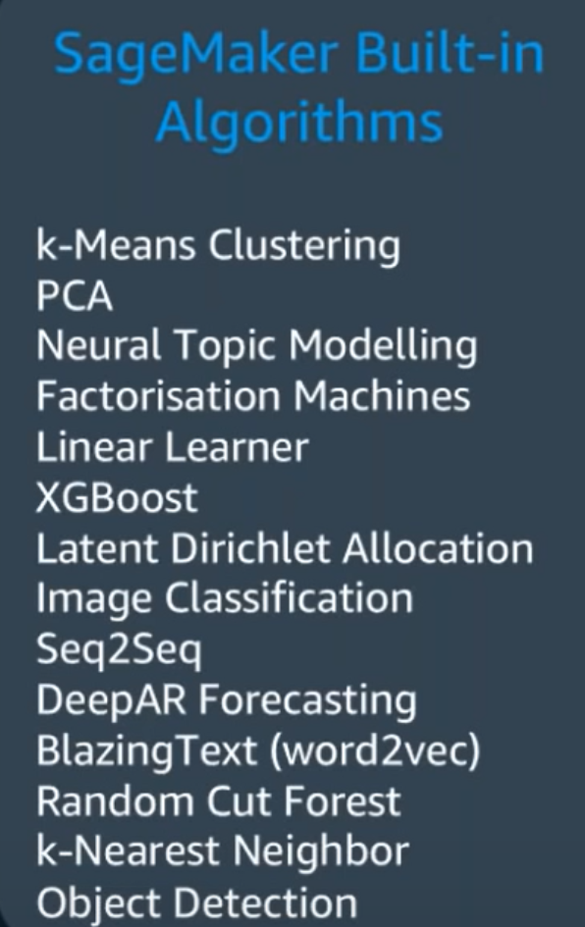
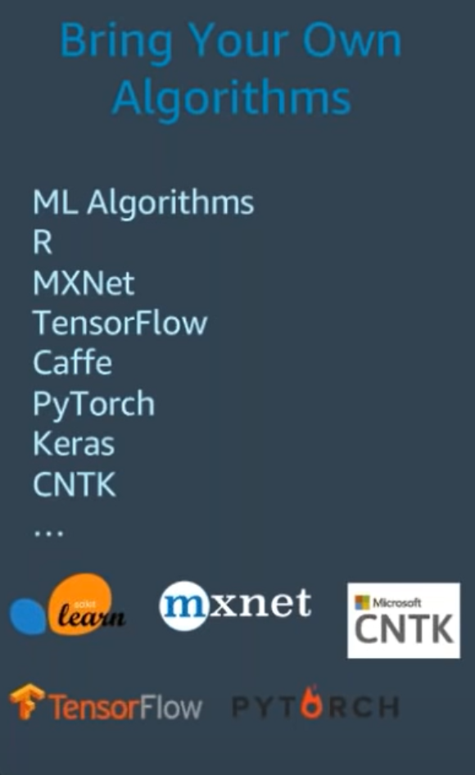
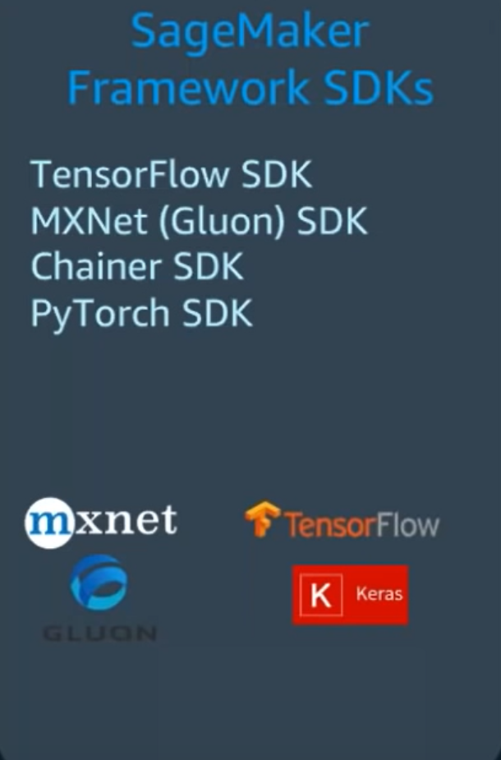
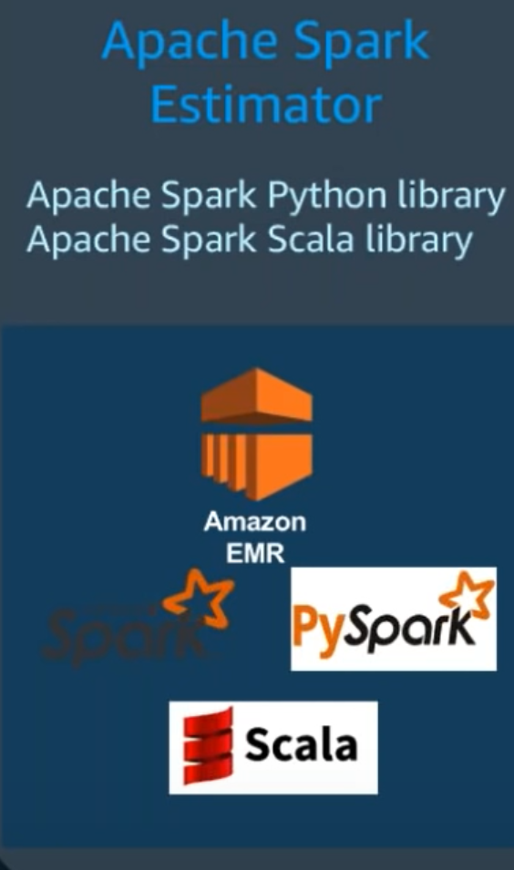
Training ML models using SageMaker

Slide 38
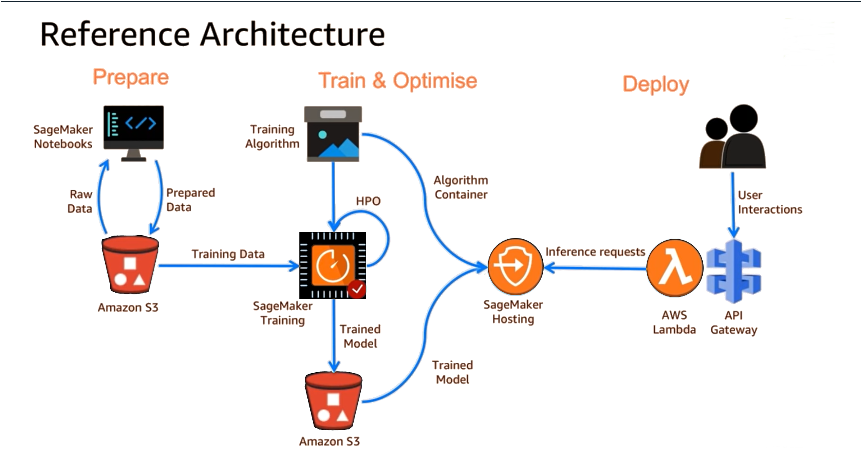

Slide 39
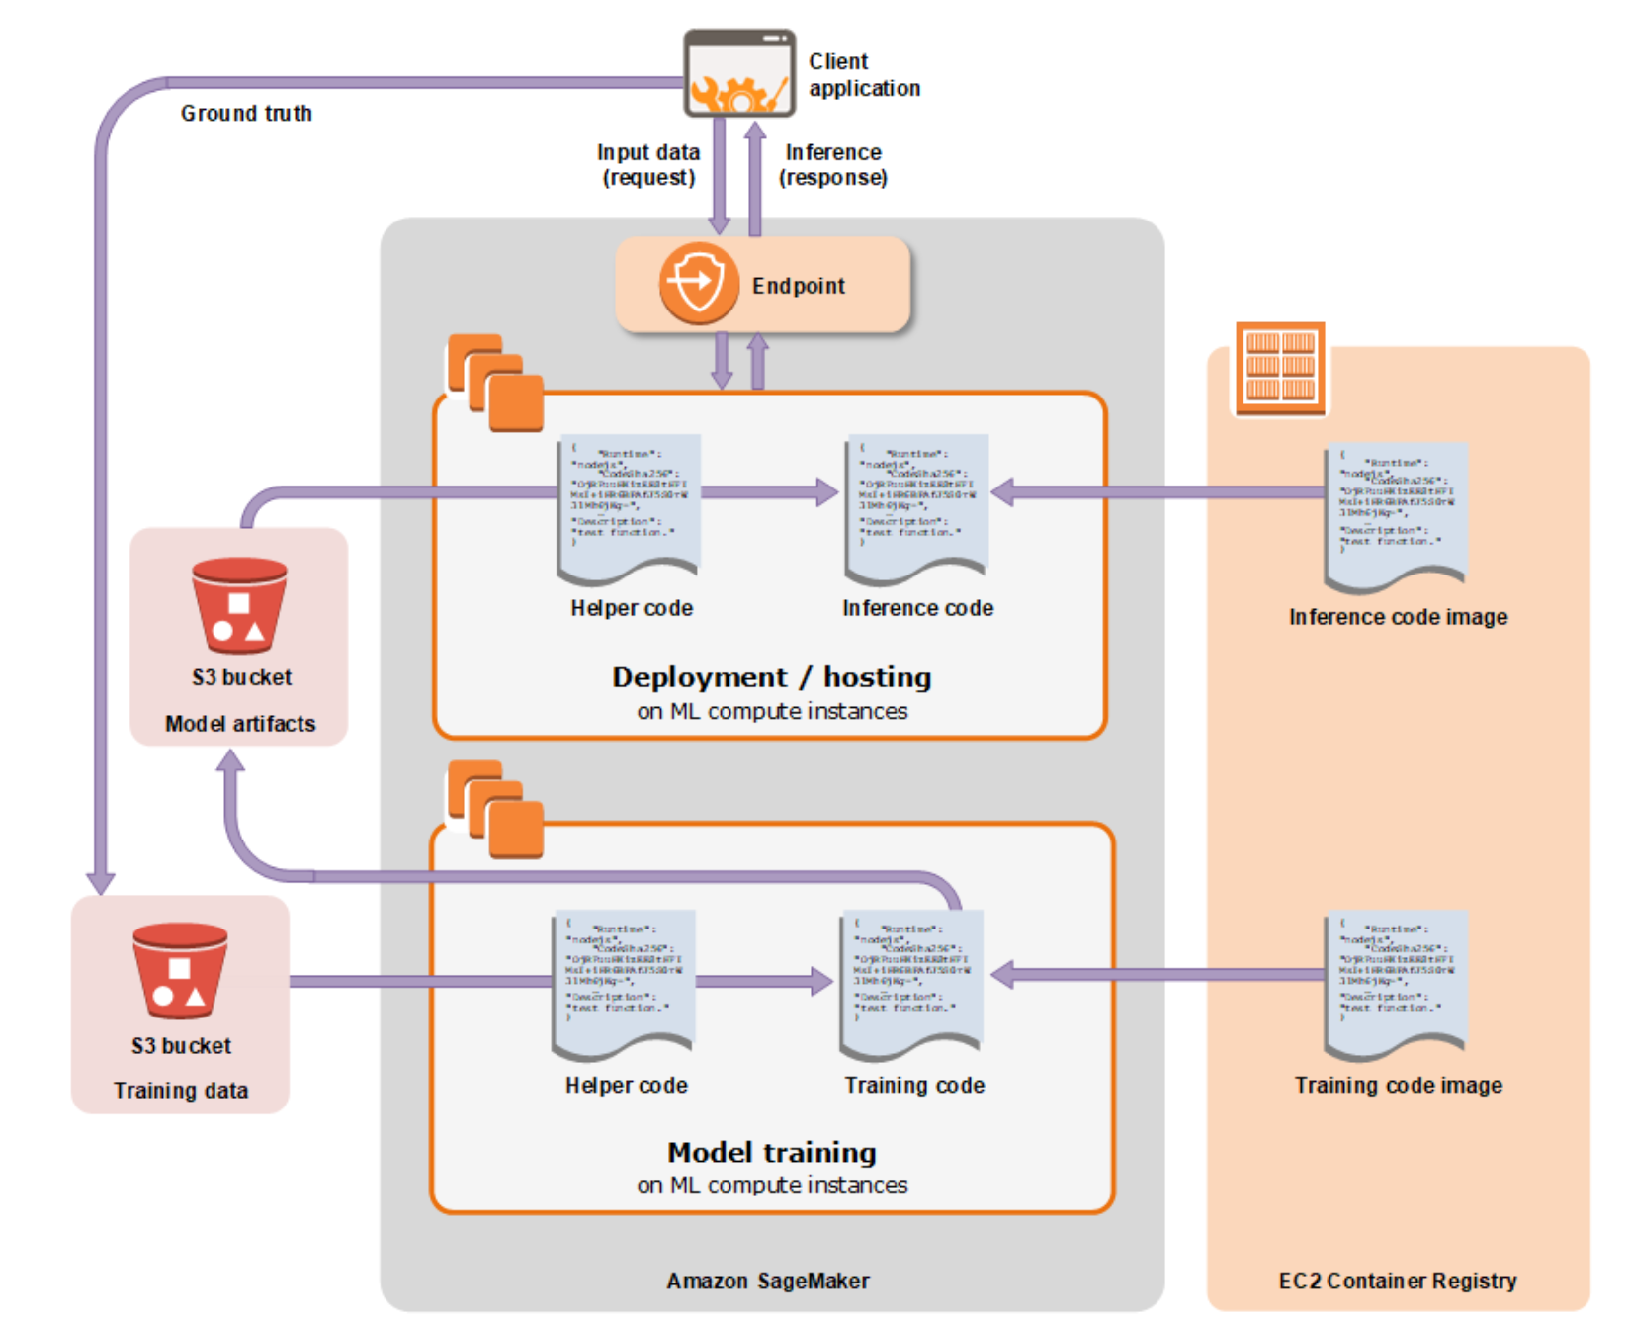

Slide 40


